Slide 1
International Conference The impact of Covid-19 on air transport / lessons learned / preparing for the future
Cyprus - 14 June 2022

Slide 2
Virtual Classroom: part of the new normal?
Paula Almeida - Director
Eric Schoonderwoerd - Business Strategist, Relationships
& CDU Manager

Slide 3
Vision/Mission Statement
Our VISION
To be the world’s best aviation learning & knowledge centre for a safer, more secure and sustainable aviation industry.
Our MISSION
To deliver the highest quality solutions for capacitating aviation professionals and organisations globally.

Slide 4
JAA Training Organisation
The JAA Training Organisation (JAA TO) is a non-profit Dutch Foundation, self funding, and the associated body of the European Civil Aviation Conference (ECAC).
JAA TO has a history of around 50 years in the Aviation Industry.
Originated from the Joint Aviation Authorities (JAA). JAA eventually transferred all its regulatory tasks to EASA.
JAA TO has the following recognitions:
ICAO Platinum Training Center of Excellence (TCE)
Member of EASA Virtual Academy (EVA)
EASA-approved RITO (Ramp Inspection Training Organisation)
A by the Dutch ‘Ministry of Justice and Security’ recognised Aviation Security training center.
Notes:
For those who are not familiar with JAA TO, a very brief introduction.

Slide 5
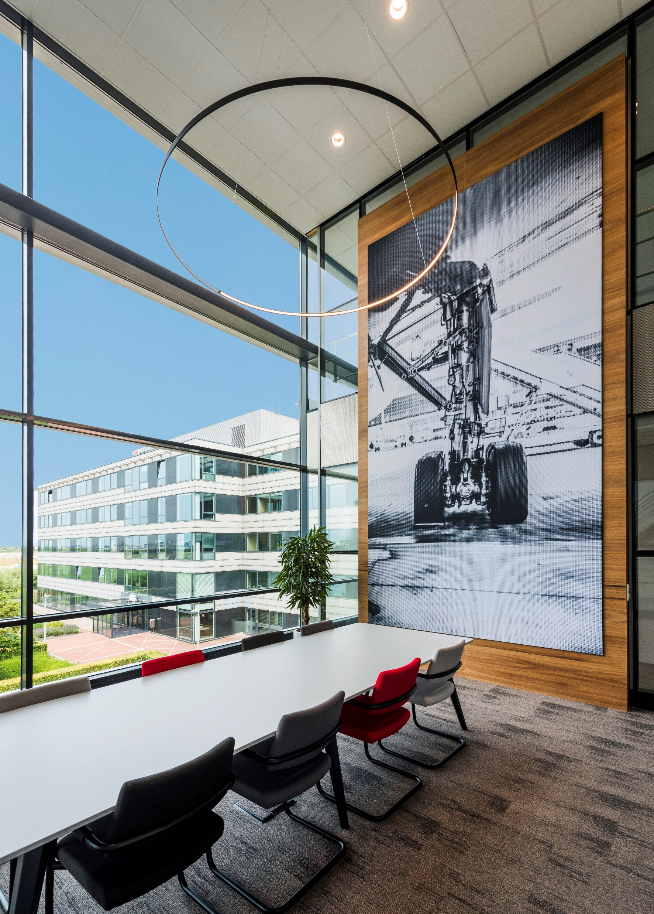
JAA Training Organisation
JAA TO delivers aviation regulatory training and additional services to capacitate aviation professionals and organisations to become and stay competent applying the regulations in practice.
Through high-standard training courses & services, JAA TO focuses on developing the highest level of professionalism and quality.
JAA TO guarantees the skills and quality of its trainers and subject matter experts through its Qualification Programme. They all are experts in their area.
JAA TO has a qualified and specialist Course Development Unit (CDU) with learning & development specialists
200+ training courses in 14 categories in the different European and worldwide regulations. (www.jaato.com)
Notes:
We have our training center close to Schiphol Airport in the Netherlands and have 200 courses in our portfolio that are delivered as online training, as an in-class course in our training center, at customer or partner location and since the crisis also as Virtual Classroom training

Slide 6
COVID-19 & Virtual Classroom
COVID-19 has impacted and affected our world, including the educational system.
March 2020 – a forced start to implementing virtual delivery.
A continuous development towards a more professional level.
Expected to remain in the post-COVID-19 period.
Virtual Classroom is defined as an online synchronous learning environment that allows for live interaction between the instructors and the learners as they are participating in learning activities.
- It is instructor led training course -
Notes:
In this 15-20 minute presentation I will present our journey from the beginning of the COVID-19 crisis until now from the forced transfer to Virtual Classroom training and the further process to the continuously improvement of this new delivery method.
It started in March 2020 with a situation that some of the trainees were already in the Netherlands or were already traveling to our training center, others were not able to travel, but the training courses needed to be delivered due to customer requirements. At that time, we started with quick and dirty placing a camera in the classroom and using an online tool - GoToMeeting. This to support all our customers with the training they need for several reasons.
But also we immediately, - in March -, started a research on Virtual Classroom - and started developing a strategy and business model for Virtual Classroom delivery. This with the expectation the crisis will be there for a long time – In the end we are now more than 2 years further. This strategy and the business model we started implementing from April 2020.
The longer the crisis continues - the more the world got familiar with working in a virtual environment, we continuously further developed the Virtual delivery methodology. Seen the acceptance in the market working in a virtual environment, it is expected that Virtual Classroom will remain in the post COVID-19 period. It saves costs and time in many cases.
To avoid confusion about what Virtual Classroom is I define it as: Virtual Classroom is defined as an online synchronous learning environment that allows for live interaction between the instructors and the learners as they are participating in learning activities. It is instructor led training course.
COVID-19 has impacted and affected our world, including the educational system.
In March 2020, we were forced to immediately switch to a different way of delivering training: Transfer to Virtual Classroom.
The longer the crisis lasted, the further the Virtual Classroom training developed to a more professional level.
Virtual Classroom training will be stay indispensable and will remain an important delivery method in the post-COVID-19 period.
JAA TO has switched promptly from the very beginning and improved the quality of the deliveries step by step.

Slide 7
Traditional and Virtual Classroom Training
It’s not simply uploading a course online by using a virtual platform.
Virtual classroom requires a different approach to engagement.
The content needs to be adapted carefully to suit the virtual delivery.
2D online environment instead of a classroom (3D).
All should not be underestimated.
When the in-class training course has been developed using the competency-based methodology, an efficient and effective transfer to the virtual delivery is much more feasible.
Notes:
Already at the start of delivering Virtual Classroom courses it came clear to us that delivering a virtual classroom course is not only using a virtual platform and deliver a classroom course via this platform.
To approach a classroom experience in a virtual environment much more is required to approach a classroom experience. One of the important topics is a different approach to engagement. Trainees are more easily distracted by all kinds of things in their environment.
It also seems easier to hide in a virtual environment and it is not easy for the instructor to keep everyone personally on track. Especially with larger groups. And the environment is a 2-dimensional environment using screens, whether a classroom environment is 3 dimensional, the atmosphere is absolutely different.
Taking this all into account virtual classroom delivery should not be underestimated.
When the in-class training course has been developed using the competency-based methodology, an efficient and effective transfer to the virtual delivery is much more feasible.
Traditional in-class training courses can’t be simply uploaded online using a virtual classroom platform or even a webinar platform. - a trap that many professionals could fall into.
The dynamics of virtual classroom training require a different approach to engagement.
The content needs to be adapted carefully to suit the virtual delivery, including practical elements.
It is important to consider the fact that trainees will be looking at a screen (2D) instead of a classroom (3D).
The virtual classroom environment is a complete other atmosphere than the classroom one.
In order to transfer classroom training courses to a professional and distinctive Virtual Classroom delivery as an addition to our course portfolio and for a successful commercialization, a lot needs to be done.
This should not be underestimated. As aforementioned, Virtual Classroom training course is not just an online version of an in-class training course delivered through an online meeting platform.
When the in-class training course has been developed using the competency-based methodology, an efficient and effective transfer to the virtual delivery is much more feasible.

Slide 8
Traditional versus Virtual Classroom Training
There are many differences in a virtual environment:
The kick-off momentum
Warm-up activities
The course content flow
The discussions
The timetable
Ability to 'read' the virtual classroom
Ability to interact with the trainees
The physical distance between trainees and instructor
Different types of distractions
Different technology
The breaks
Use of break-out rooms
Conducting exercises and activities
The existence of many different physical environments
Notes:
A lot is different. This sheet shows some differences. I will only mention a few as example:
Kick-off: when delivering a classroom course all trainees meet at the training center, mostly at the coffee corner. Having an informal talk with each other and the instructor. Then everybody goes to the classroom and start the course.
In a Virtual classroom everybody see and meet each other at the beginning of the course, having maybe difficulties with the connection etc..
Distractions are different. At home or in the office you can de distracted by colleagues or partner or children. It’s more easy to become distracted than in a Classroom.
Time Table is different. In a classroom the sessions to the next break can be longer

Slide 9
Traditional and Virtual Classroom Training
Notes:
In this sheet again some differences seen from 6 perspectives. Some are similar to the previous sheet. One specific is the social interaction. Another is Practice.

Slide 10
Delivering Virtual Classroom Training
The following 3 elements are important when developing or transforming a training course for virtual delivery:
Choose the right delivery platform and tools.
Develop course content for virtual classroom delivery.
The delivery process and experience.
Notes:
Following the right steps in delivering virtual classroom courses this sheet shows the steps that in a normal solution need to be taken.
Because of the crisis we were forced to do all steps parallel, but during the delivery of the first courses, we started with a structured review of the available platforms and after using GoToMeeting, Webex, Team and Zoom we have chosen for the Zoom platform.
Immediately after this decision we started developing guidelines for optimising content for Virtual Delivery and start developing a training course for our instructors how to deliver a Virtual Course.

Slide 11
Competency-Based Training & Assessment
Definition of Competency Based Training:
Competency-based training is a method of training which develops the skills, knowledge and attitudes required to achieve competency/competent professional.
The goal of competency-based training is:
Perform a job applying the competencies – K/S/A – identified for the job, to the required standard (criteria) for the job.
To focus training to specific competencies that an individual has not yet attained.
To see evidence of a change in their behavior and performance following that training.
Training generally focuses on obtaining a change in an individual’s behavior.
Notes:
As mentioned in an earlier sheet using the Competency Based Training & Assessment methodology it will guide the development and delivery of a Virtual Classroom course in a professional way. I’m not going to explain the methodology in detail further, many can be found on the internet. I only want to highlight a few topics in the next sheet.
There are many descriptions of competency based training. Competency-based training is a method of training which develops the skills, knowledge and attitudes required to achieve competency and that focuses on a learner’s ability to receive, respond to and process information in order to achieve that competency

Slide 12
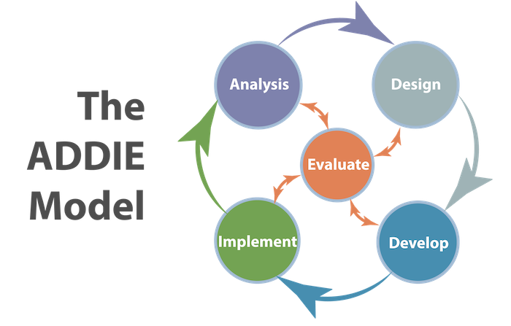
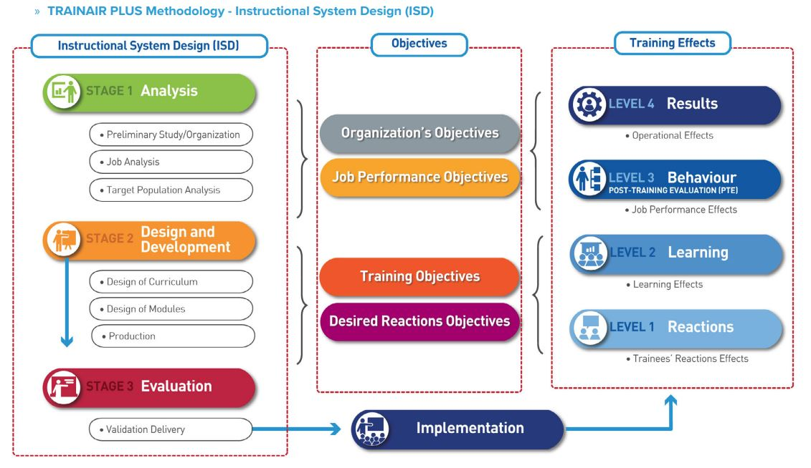
Course Development
Competency-based development methodology:
Structure each training module/segment with a short duration (maximum 60-90 minutes each).
Time management.
Interactive elements
Preparing effective presentation.
ADDIE/ICAO Methodology.
Notes:
Just a few topics of CBTA delivery. Because CBTA is goal oriented and based on the tasks it requires to structure the course in different modules and therefore able to manage short duration modules of 60-90 min.
Seen it is competency based and this needs to be monitored and measured many interactive elements are required to create optimal engagement. Which is one of the most important challenges during the delivery of a virtual classroom course.
We as JAA TO use the ADDIE methodology and the ICAO Instructional Design for courses that will be approved by ICAO.

Slide 13
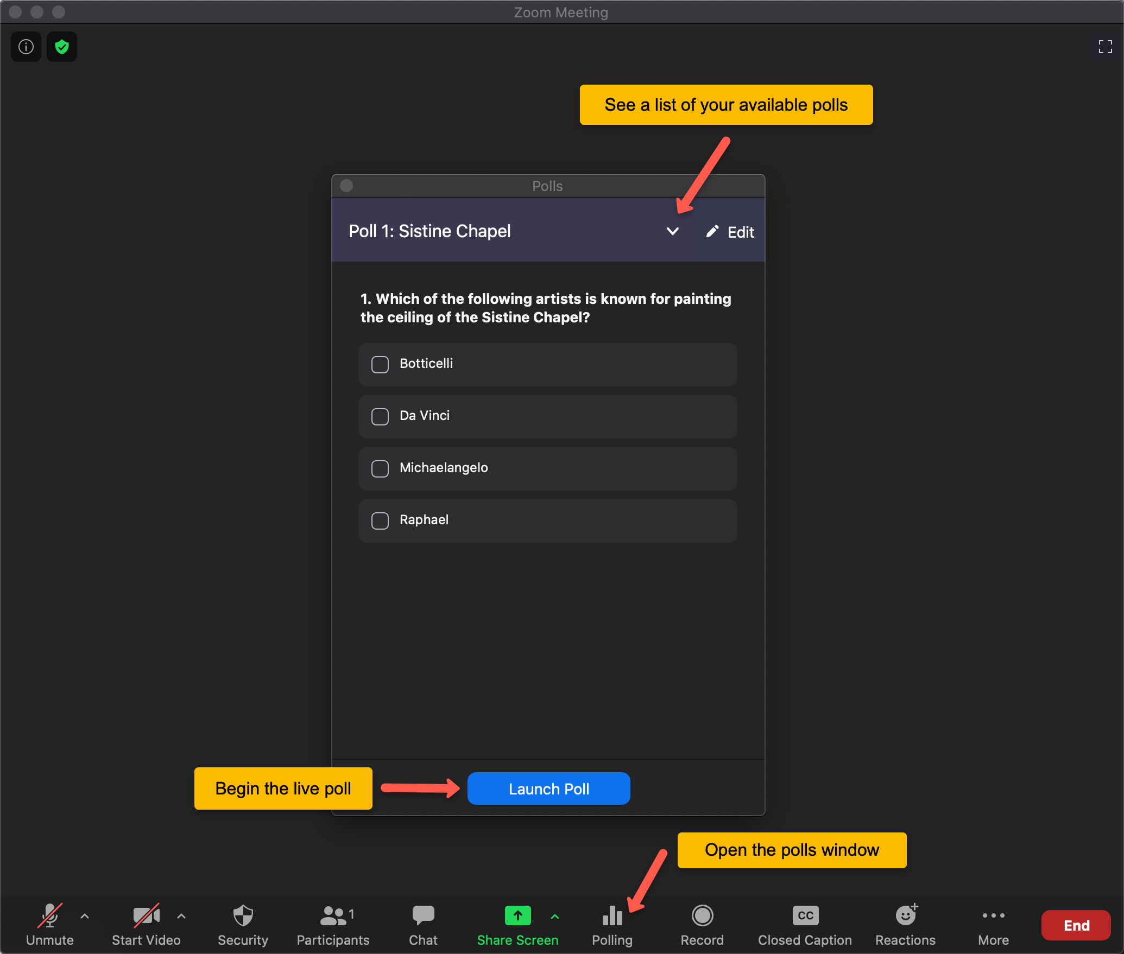
Main tools and functionalities
Online video tools
Screen sharing
Digital whiteboard
Virtual breakout rooms
Transferring files
Communication via chat box
Engagement of trainees:
Quizzes
Polls
Chat option
Notes:
This screen shows some specific tools that can or need to be used in Virtual Classroom course development and delivery.

Slide 14
Delivering a Virtual Classroom Training
Training of competent instructors:
How to transfer in-class courses to virtual classroom courses.
The use of the chosen platform – technical skills.
How to engage the trainees.
Ensuring a proper time management.
Clear instructions to the trainees.
Clear instructions in case something goes wrong.
Notes:
Developing a course optimised for Virtual Classroom delivery is not enough. It also needs to be delivered differently. Therefore we have developed a Virtual Training course for our instructors

Slide 15
Contact details
Eric Schoonderwoerd
E-mail: eschoonderwoerd@jaato.com
Telephone: +31 23 56 797 97
Mobile: +31 6 28 91 70 48
Linkedin: linkedin.com/in/ericschoonderwoerd

